Slide 1





Internship 6.0
Food Trends Understanding Customer Preferences in Food & Beverage

Slide 2
TEAM MEMBERS
Tirumala Bekkam
Shivatharani
Kshitija
Parthiv Rishi
Maithili
Anjali
Anish Mane

Slide 3

INTRODUCTION
The project focuses on analyzing customer food preferences and dietary habits.
The dataset includes attributes such as age, gender, activity level, dietary preference, calories, nutrients, diseases, price, and ratings.
Objective: To gain insights into how lifestyle, diet type, and pricing impact food choices and nutritional balance.
Additionally, the project aims to identify patterns that can help recommend healthier and more cost-effective meal options for different customer segments.

Slide 4
DATASET OVERVIEW
Demographics: Age, Gender, Height, Weight
Lifestyle: Activity Level, Daily Calorie Target
Nutrition: Protein, Fat, Carbohydrates, Sugar, Fiber, Sodium, Calories
Food Suggestions: Breakfast, Lunch, Dinner, Snack
Health & Cost: Diseases, Price, Rating
Dataset was analyzed using Power BI to create interactive dashboards for trend analysis.

Slide 5
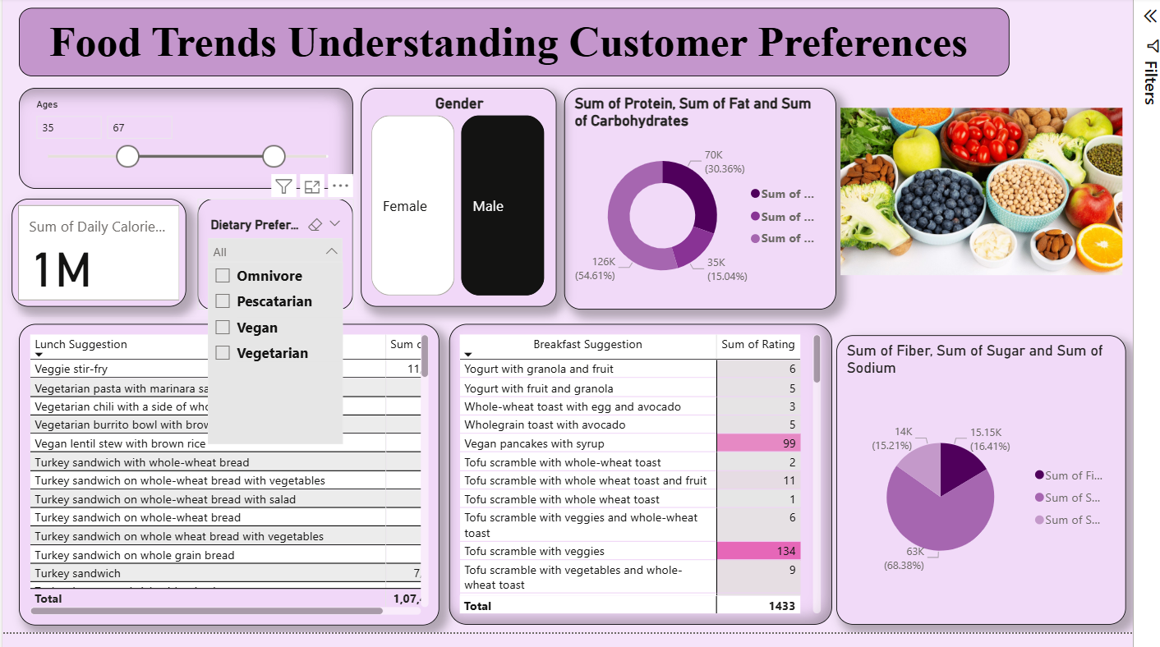
FOOD TRENDS OVERVIEW

Slide 6
customers fall in the 18–79 age group.
Gender distribution is nearly balanced.
Total calorie intake: 1M+
Donut charts show proportions of macronutrients (Protein, Fat, Carbs).
Top Lunch Suggestions: Veggie stir-fry, Vegetarian chili, and Vegetarian Pasta
High-rated breakfast items include tofu scramble and vegan pancakes.

Slide 7
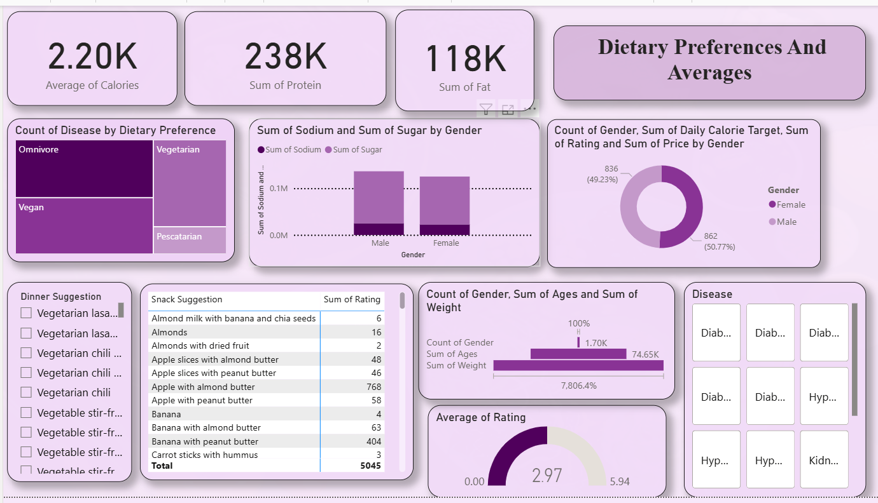
DIETARY PREFERENCES & AVERAGES

Slide 8
Highest calorie average: 2.2K
Protein and fat intake analyzed by gender.
Omnivores have higher disease counts compared to vegans and vegetarians.
Females and males show similar calorie target adherence (around 50% each).
Average Rating: ~3, showing moderate satisfaction across diets.

Slide 9
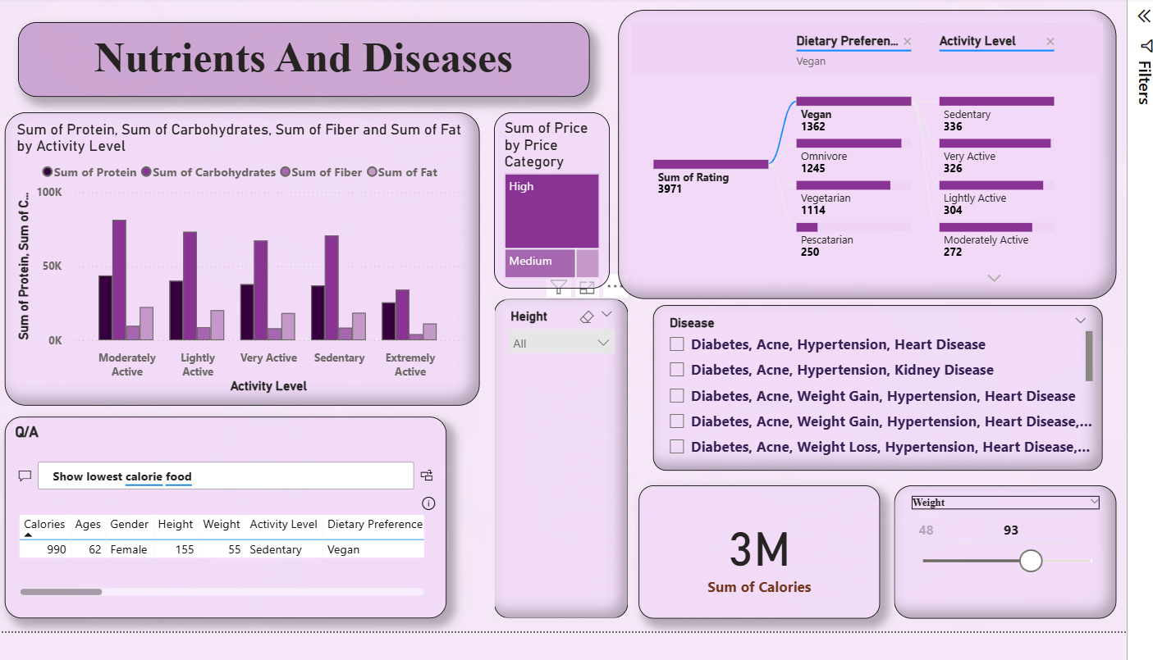
NUTRIENTS & DISEASES

Slide 10
Nutrient distribution analyzed by activity level (Sedentary to Extremely Active).
Highly active individuals consume more protein and carbohydrates.
Disease patterns reveal correlation between sedentary lifestyle and conditions like diabetes, hypertension, and obesity.
Q&A feature used for interactive queries like “Show lowest calorie food.”
Height ranges from 150 to 200 CM

Slide 11
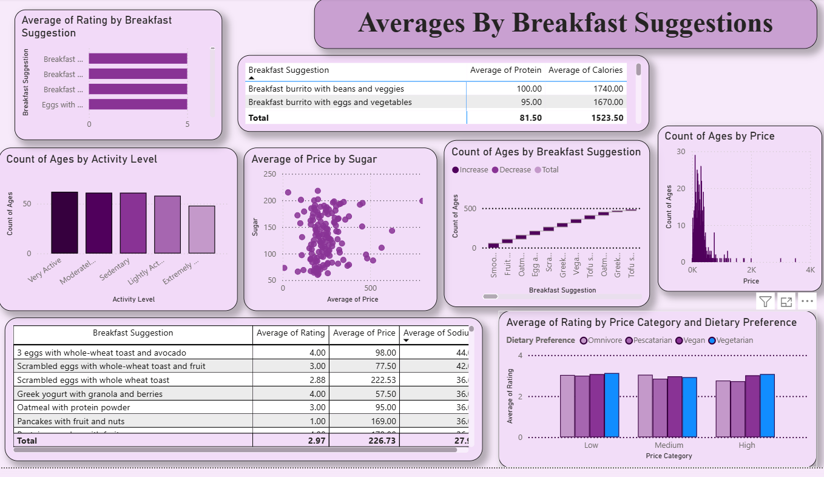
BREAKFAST ANALYSIS

Slide 12
Breakfast suggestions were analyzed by rating, price, calorie, and nutrient composition.
“Breakfast burrito with beans and veggies” shows the highest nutrition value with 100 g protein and 1740 calories.
The scatter plot of sugar vs. price shows that most items cluster in the average price range, confirming a balance between sweetness and affordability.
Omnivore and vegetarian options tend to receive slightly higher ratings in low-price categories, indicating strong satisfaction even at lower cost.
Count-of-ages by activity level shows breakfast popularity is highest among moderately and very active individuals.

Slide 13
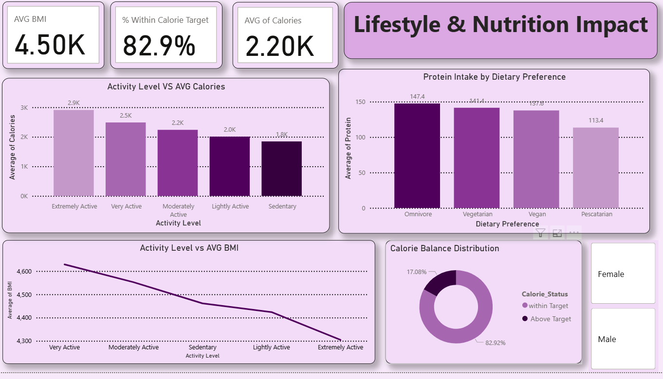
LIFESTYLE & NUTRITION IMPACT

Slide 14
Relationship between activity level, calories, BMI, and dietary preference.
Highly active individuals maintain better BMI and balanced calorie intake.
Protein intake highest among omnivores, followed by vegetarians.
Over 82.9% of participants are within their calorie target.
As activity level increases, average BMI tends to decrease, showing a clear connection between fitness and healthy body composition.

Slide 15
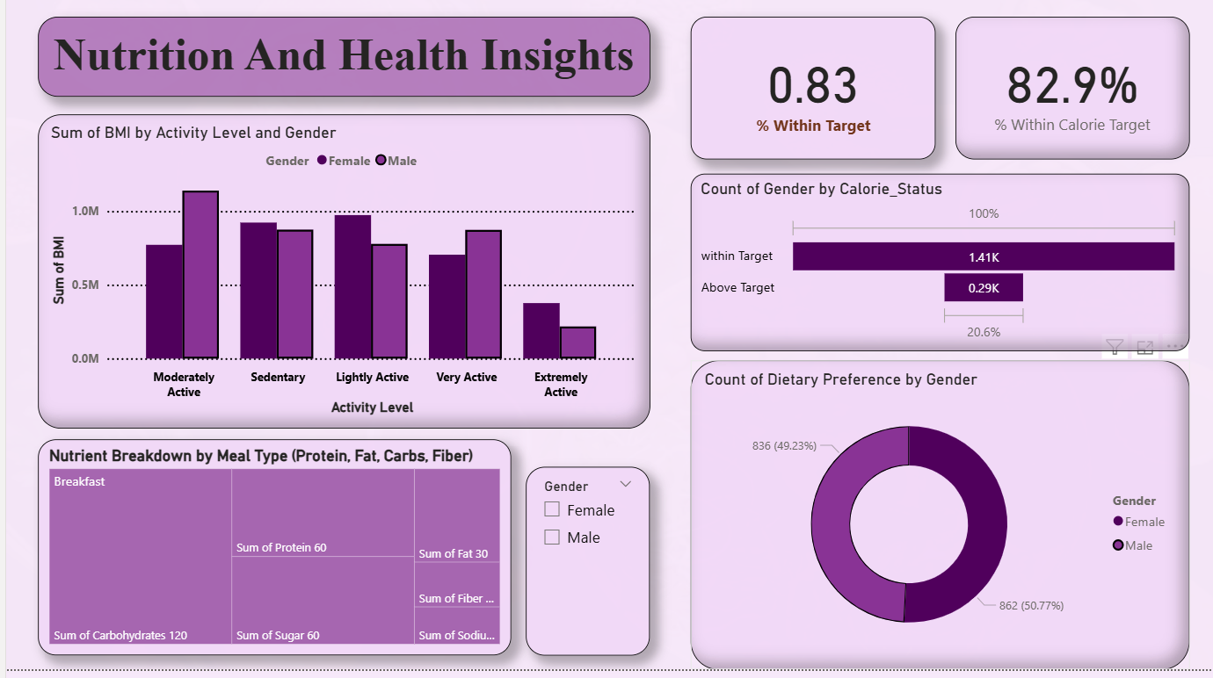
Nutrition & Health Insights

Slide 16
BMI comparison by gender and activity level.
Males show slightly higher BMI in sedentary categories.
Nutrient breakdown highlights carbs and protein as major contributors.
Donut chart shows near-equal distribution of dietary preference by gender.

Slide 17
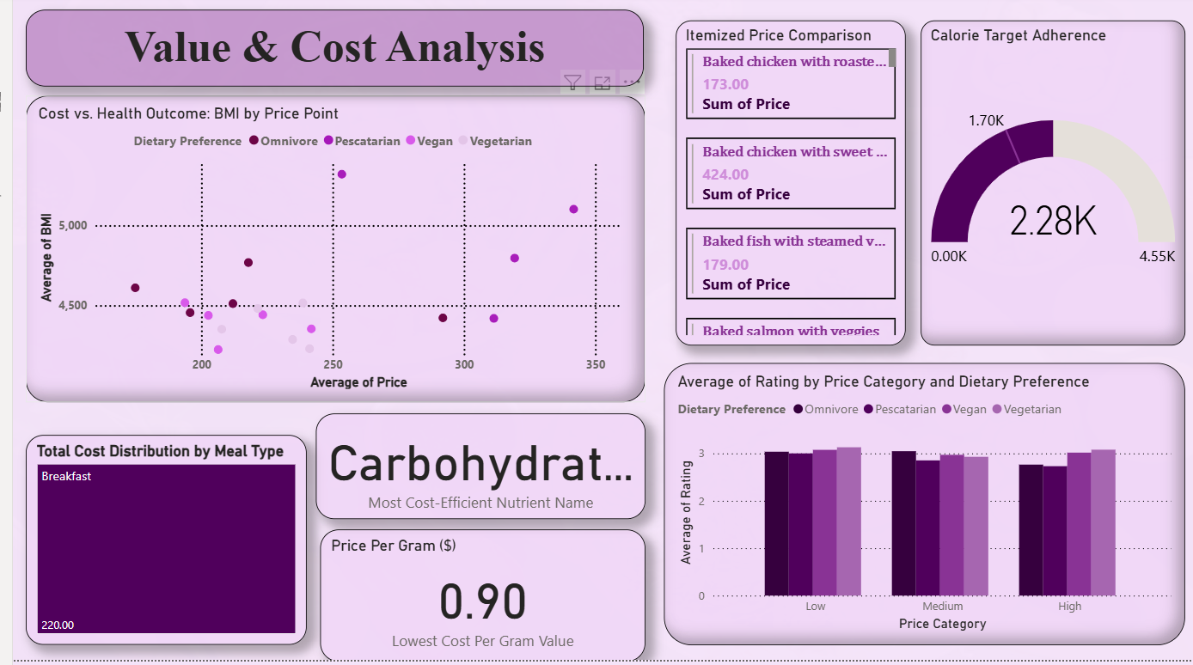
VALUE & COST ANALYSIS

Slide 18
Comparison of BMI vs. Price Point for different diet types.
Carbohydrates identified as the most cost-efficient nutrient (lowest cost per gram = 0.90$).
Vegetarian meals show high ratings even at low and medium price ranges.
Cost-efficient meals can maintain health balance without overspending.

Slide 19
CONCLUSION
Consumers prefer balanced, moderately priced meals.
Vegans and vegetarians show better calorie control and disease management.
Activity level directly affects calorie and BMI balance.
Nutritional awareness is higher in people following custom diet plans.
The dashboards help visualize relationships between food choice, cost, and health for data-driven insights.

Slide 20
FUTURE SCOPE
Integrate real-time food tracking and customer feedback analytics.
Predict personalized meal plans using machine learning.
Extend research to include regional food preferences.
Develop a mobile dashboard for interactive health insights.
Implement AI-driven recommendations for pricing and menu optimization.

Slide 21
THANK YOU !

